Slide 1

Visualize Data with
Slides CC BY-SA RStudio

Slide 2

(Applied) Data Science
Visualize
Import
Tidy
Model
Communicate
Transform
2
Program

Slide 3

"The simple graph has brought more information to the data analyst’s mind than any other device. "
- John Tukey

Slide 4
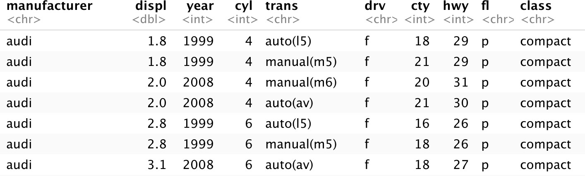
mpg
Fuel economy data for 38 models of car.
mpg

Slide 5
Quiz
Confer with your group.
What relationship do you expect to see between engine size (displ) and mileage (hwy)?
No peeking ahead!
5

Slide 6

Your Turn 1
Run this code in 02-Visualize-Exercises.Rmd to make a graph. Pay strict attention to spelling, capitalization, and parentheses!
ggplot(data = mpg) +
geom_point(mapping = aes(x = displ, y = hwy))
6

Slide 7
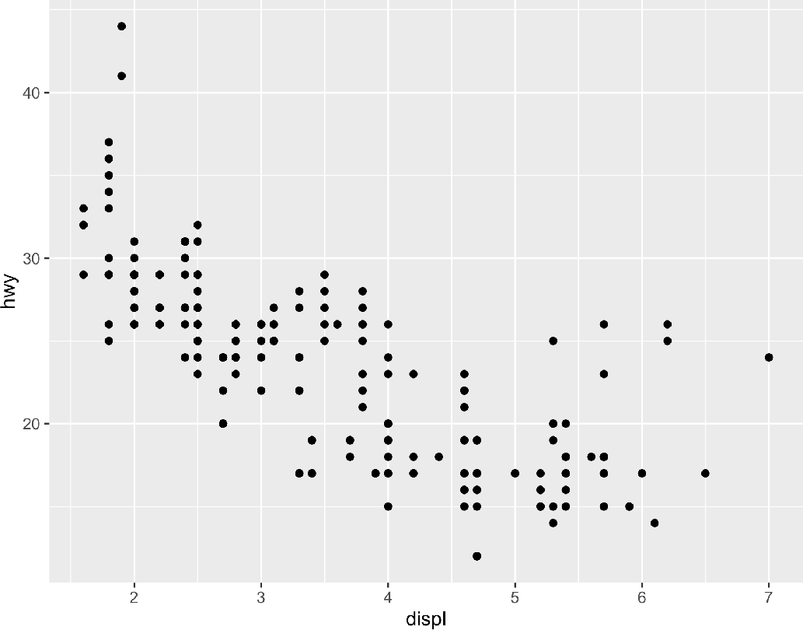
ggplot(data = mpg) +
geom_point(mapping = aes(x = displ, y = hwy))

Slide 8
1. "Initialize" a plot with ggplot()
2. Add layers with geom_ functions
ggplot(data = mpg) +
geom_point(mapping = aes(x = displ, y = hwy))
8

Slide 9
Pro tip: Always put the + at the end of a line, Never at the start
ggplot(data = mpg) +
geom_point(mapping = aes(x = displ, y = hwy))
9

Slide 10
data + before new line
ggplot(data = mpg) +
geom_point(mapping = aes(x = displ, y = hwy))
type of layer
aes()
x variable
y variable
10

Slide 11
A template
ggplot(data = <DATA>) +
<GEOM_FUNCTION>(mapping = aes(<MAPPINGS>))
geom_point(mapping = aes(x = displ, y = hwy))
ggplot(data = mpg) +

Slide 12
A template
ggplot(data = <DATA>) +
<GEOM_FUNCTION>(mapping = aes(<MAPPINGS>))

Slide 13


Mappings
13

Slide 14
"The greatest value of a picture is when it forces us to notice what we never expected to see."
- John Tukey

Slide 15
How can we test the theory?
Why do these cars get better mileage?
ggplot(data = mpg) +
geom_point(mapping = aes(x = displ, y = hwy))

Slide 16
Aesthetics
1.4
1.4
1.4
1.4
1.2
1.2
1.2
1.2
1
1.0
1
1.0
1
1.0
1
1.0
0.8
0.8
0.8
0.8
0.6
0.6
0.6
0.6
0.6
0.8
1.0
1
1.2
1.4
0.6
0.8
1.0
1
1.2
1.4
0.6
0.8
1.0
1
1.2
1.4
0.6
0.8
1.0
1
1.2
1.4
16

Slide 17
Visual Space
color
Data Space
class
2seater compact midsize minivan pickup subcompact suv
Red Brown Green Aqua Blue Violet Pink
17

Slide 18
Aesthetics
aesthetic property
Variable to map it to
ggplot(mpg) | + | geom_point(aes(x | = | displ, | y | = | hwy, | color | = | class))
ggplot(mpg) | + | geom_point(aes(x | = | displ, | y | = | hwy, | size | = | class))
ggplot(mpg) | + | geom_point(aes(x | = | displ, | y | = | hwy, | shape | = | class))
ggplot(mpg) | + | geom_point(aes(x | = | displ, | y | = | hwy, | alpha | = | class))
18

Slide 19

Your Turn 2
In the next chunk, add color, size, alpha, and shape aesthetics to your graph. Experiment.
Do diﬀerent things happen when you map aesthetics to discrete and continuous variables?
What happens when you use more than one aesthetic?
19

Slide 20
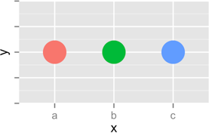
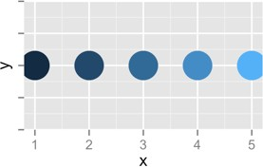
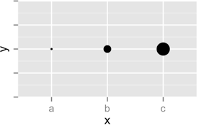
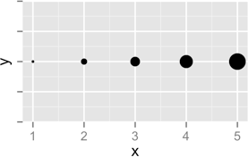
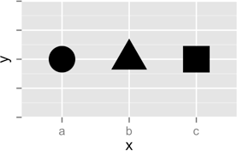
Discrete
Continuous
Color
Size
Shape
20

Slide 21
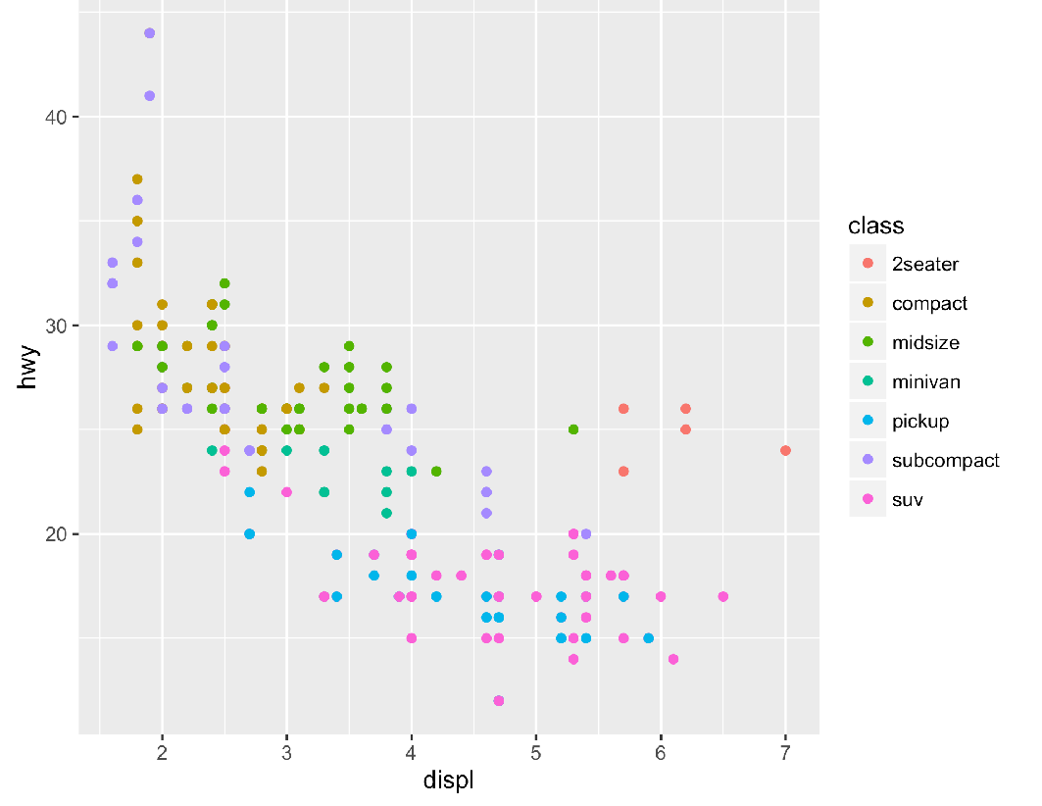
Legend added automatically
ggplot(data = mpg) +
geom_point(mapping = aes(x = displ, y = hwy, color = class))

Slide 22
Error!
ggplot(data = mpg) +
geom_point(mapping = aes(x = displ, y = hwy), color = class)

Slide 23
Facets
23

Slide 24

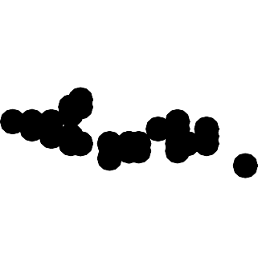








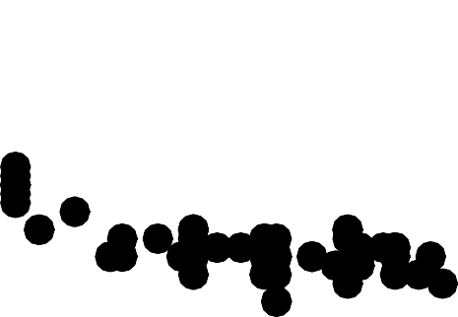

Facets
Subplots that display subsets of the data.
2seater
compact
midsize
40
30
20
minivan
pickup
subcompact
40
30
20
hwy
suv
2 3 4 5 6 7
2 3 4 5 6 7
40
30
20
2 3 4 5 6 7
displ
CC by RStudio

Slide 25

Help me
What do facet_grid and facet_wrap do?
q <- ggplot(mpg) + geom_point(aes(x = displ, y = hwy)) q + facet_grid(. ~ cyl)
q + facet_grid(drv ~ .)
q + facet_grid(drv ~ cyl) q + facet_wrap(~ class)
25
CC by RStudio

Slide 26
summary
facet_grid() - 2D grid, rows ~ cols, . for no split
facet_wrap() - 1D ribbon wrapped into 2D
26
CC by RStudio

Slide 27
A ggplot2 template
Make any plot by filling in the parameters of this template
ggplot(data = <DATA>) +
<GEOM_FUNCTION>(mapping = aes(<MAPPINGS>)) +
<FACET_FUNCTION>
27
CC by RStudio

Slide 28
Your Turn 3
Add the black code to your graph. What does it do?
ggplot(data = mpg) +
geom_point(mapping = aes(displ, hwy, color = class)) + labs(title = "Fuel Efficiency by Engine Size",
subtitle = "Data facetted by class",
x = "Engine Size (displacement in liters)", y = "Fuel Efficiency (MPG)",
color = "Class of\nAutomobile",
caption = "Data from the EPA")
28
CC by RStudio

Slide 29
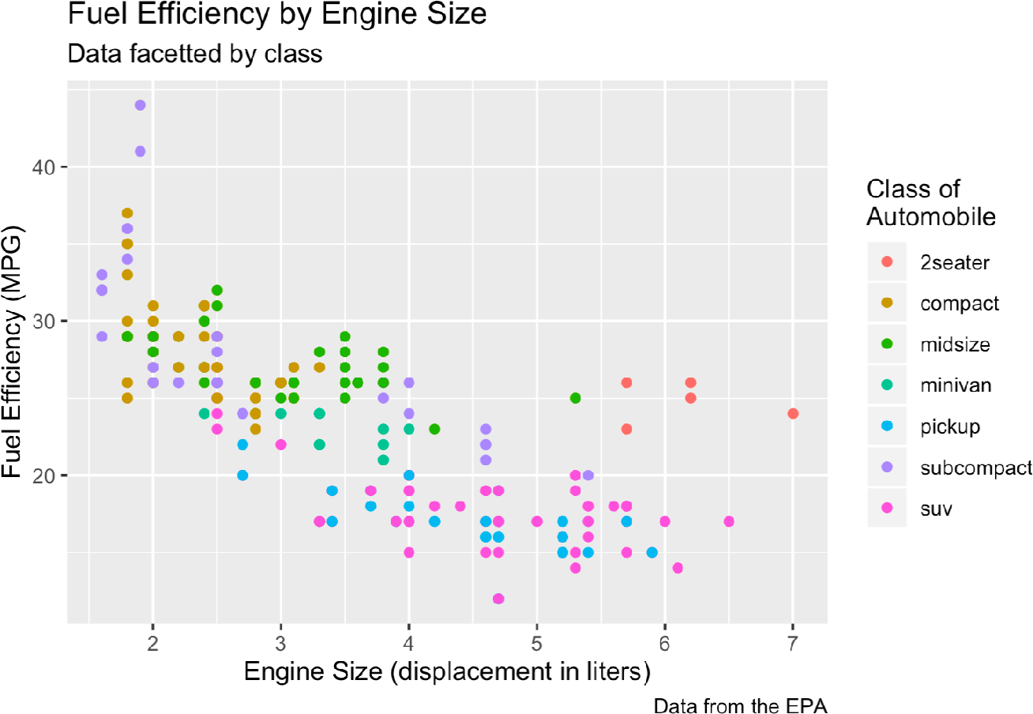
Title
SUBTitle
color
y
caption
x
29
CC by RStudio

Slide 30
Geoms
30

Slide 31
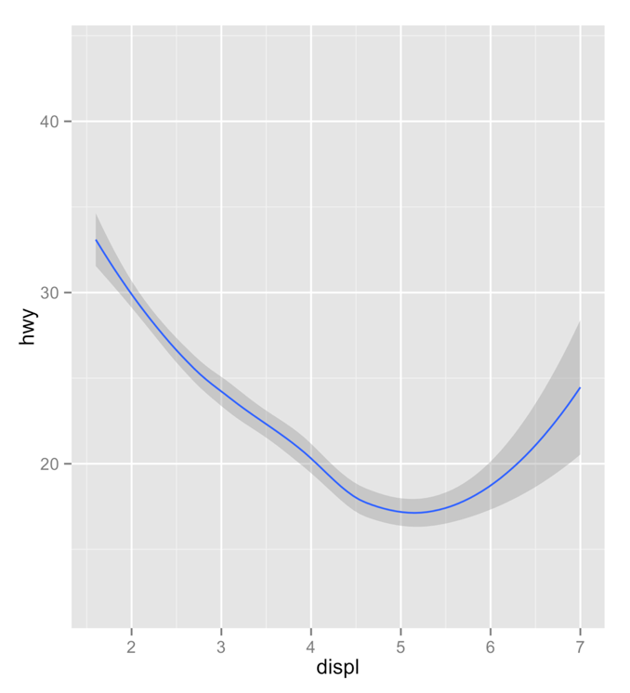
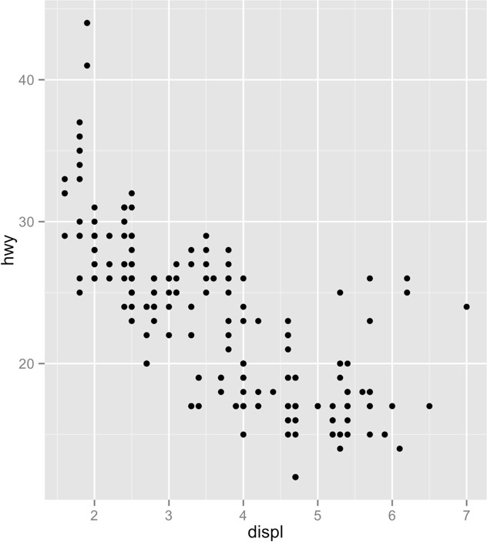
Same:
How are these plots similar?
x var , y var , data
●
●
●
●
●
●
● ●
●
●
● ●●
● ● ●
● ● ● ● ●● ●
● ● ● ● ●
● ● ●● ● ● ● ●
● ● ● ●● ● ●● ●● ● ●
● ● ● ●● ● ●
●● ●● ●
● ●
●
●
●
●
●
●
● ● ●
●
●
●
●
●
●
●
●
●
●
●
●
●
●●
●
●
●
●●
 | ● ● | ● ● | ● | ●●
●● | ●● | ● ●● | ● ● ● | ● | ● ●
 |  | ●● | ● ●
 | ● | ●● | ●●● | ● | ●
 |  | ● | ● |  | ●

Slide 32
How are these plots diﬀerent?
Diﬀerent: geometric object (geom),
e.g. the visual object used to represent the data

Slide 33
geoms
ggplot(data = <DATA>) +
<GEOM_FUNCTION>(mapping = aes(<MAPPINGS>))
33

Slide 34

rstudio.cloud/learn/cheat-sheets
Click
Cheat Sheets
in the sidebar

Slide 35
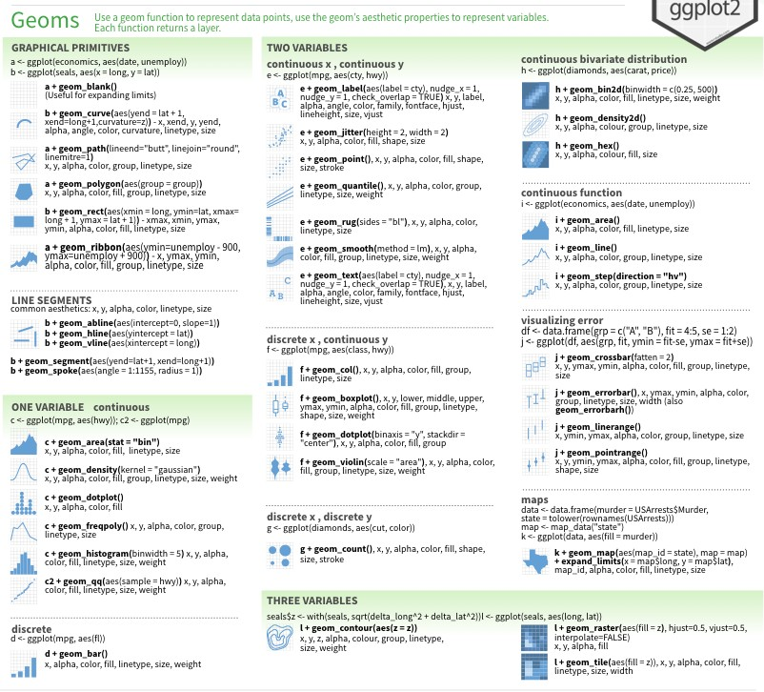
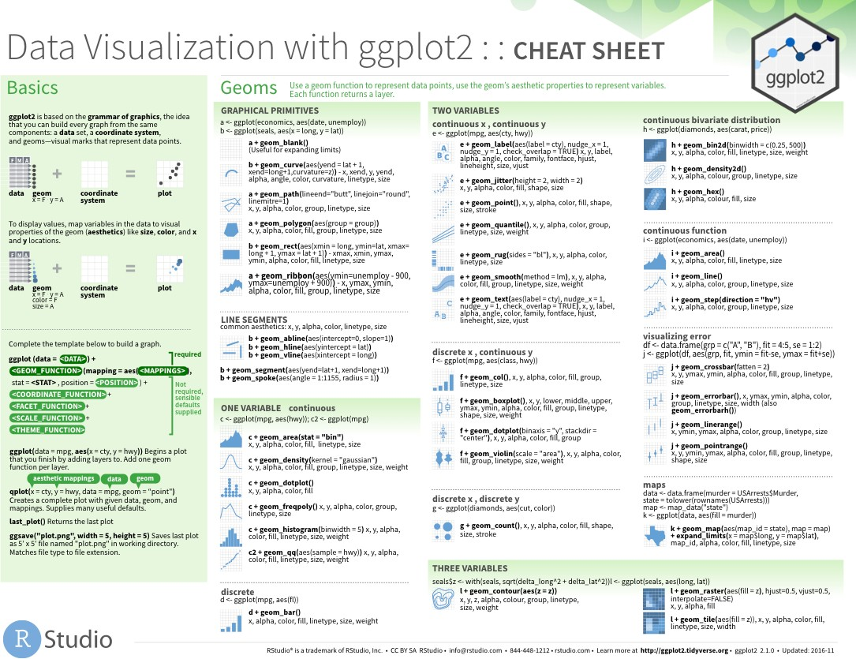
geom_ functions
Each requires a mapping argument.

Slide 36
Your Turn
Pair up.
36

Slide 37
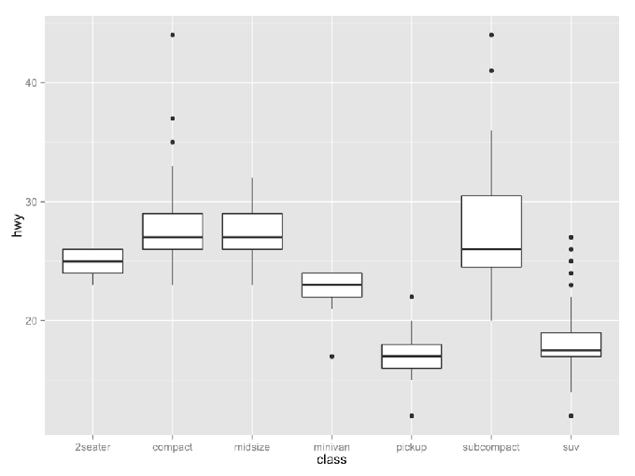
Your Turn
With your partner, decide how to replace this scatterplot with one that draws boxplots. Use the cheatsheet. Try your best guess.
●
●
40
●
●
●
35
●
●
●
●
●
●
●
30
●
●
●
hwy
●
●
●
●
●
●
●
●
●
●
●
●
●
●
●
●
●
●
●
●
25
●
●
●
●
●
●
●
●
●
●
●
●
●
●
●
●
●
●
●
20
●
●
●
●
●
●
●
●
●
●
●
●
●
15
●
●
●
2seater
compact
midsize
minivan
class
pickup
subcompact
suv
ggplot(mpg) + geom_point(aes(class, hwy))

Slide 38
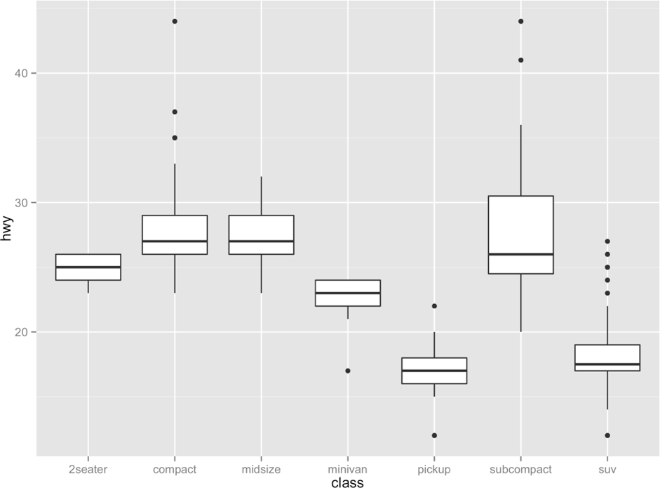
ggplot(data = mpg) +
geom_boxplot(mapping = aes(x = class, y = hwy))

Slide 39
Your Turn 5
With a partner, make the histogram of hwy below. Use the cheatsheet. Hint: do not supply a y variable.
40
30
count
20
10
0
10
20
hwy
30
40

Slide 40
40
30
count
20
10
0
10 20 30
40
hwy
ggplot(data = mpg) + geom_histogram(mapping = aes(x = hwy))

Slide 41
Quiz
40
30
count
What is the diﬀerence?
20
10
0
10
20
hwy
30
40
40
30
count
20
10
0
41
10
20
hwy
30
40

Slide 42
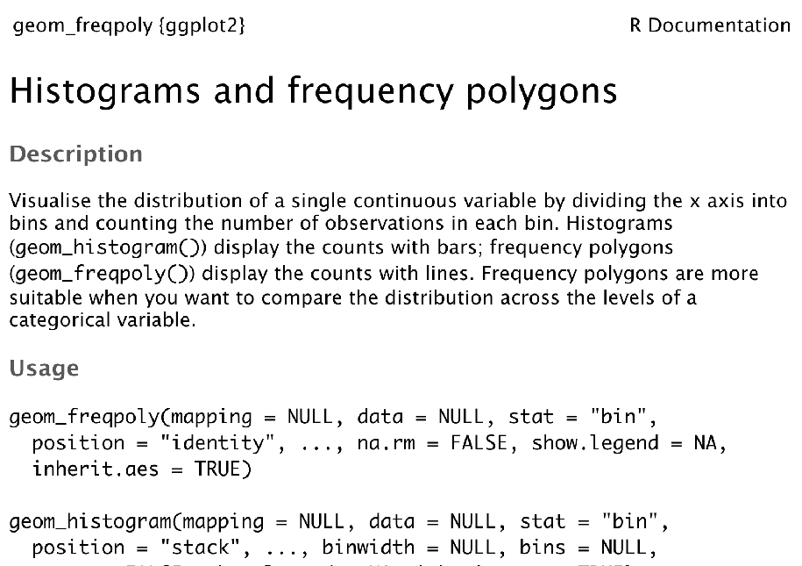
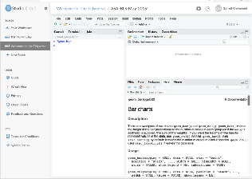
"Help" pages
To open the documentation for a function, type
?geom_histogram
function name (no parentheses)
?

Slide 43
Tips
scan page for relevant info
ignore things that don't make sense
try out the examples

Slide 44
Your Turn 6
Use the help page for geom_histogram
to make the bins 2 mpg wide.
40
30
count
20
10
0
10
20
hwy
30
40

Slide 45
40
30
count
20
10
0
10 20 30 40
hwy
ggplot(data = mpg) +
geom_histogram(mapping = aes(x = hwy), binwidth = 2)

Slide 46
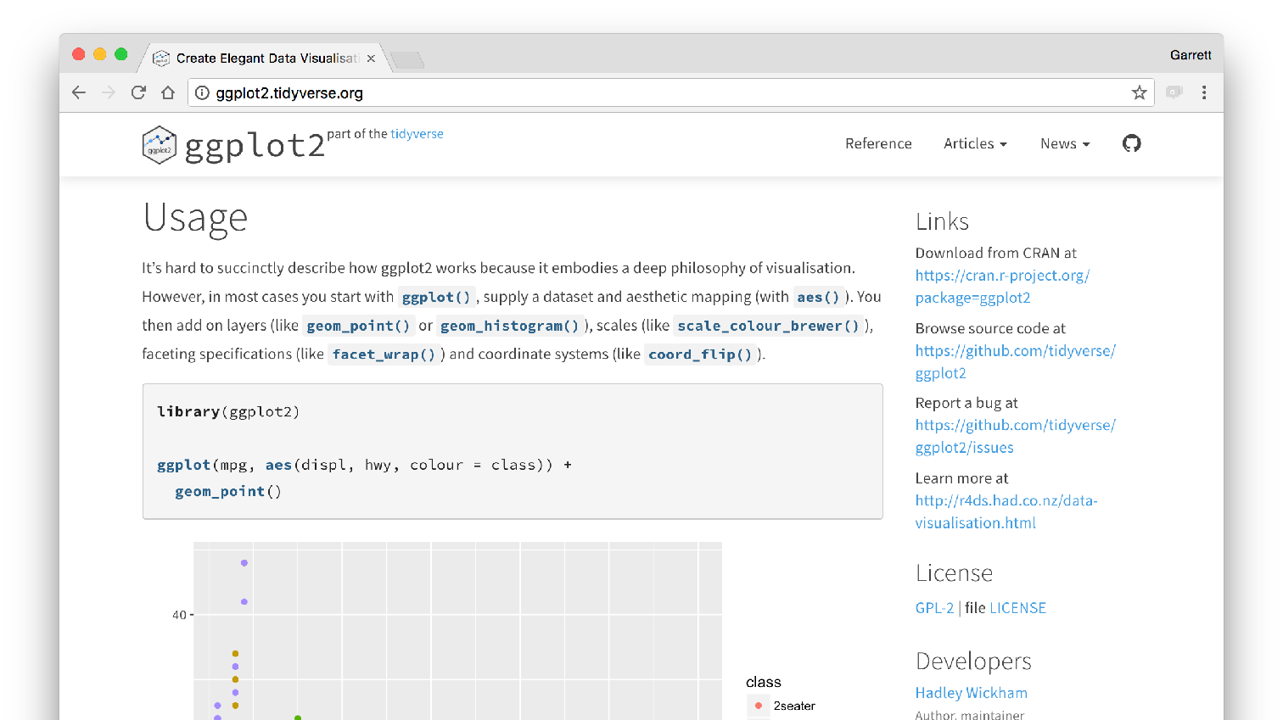
ggplot2.tidyverse.org/

Slide 47
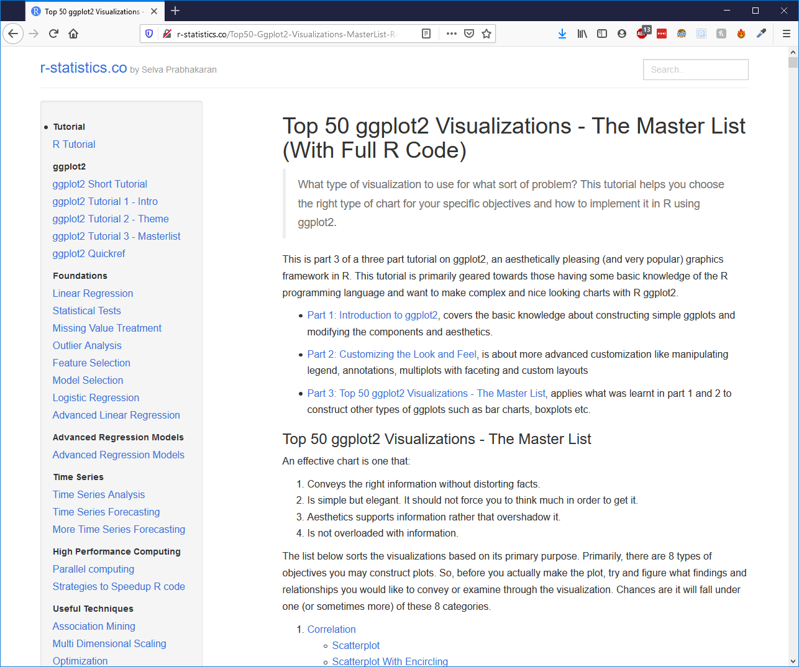
r-statistics.co

Slide 48
Your Turn 7
With a partner, make the bar chart of class below. Use the cheatsheet. Hint: do not supply a y variable.
60
class
40
2seater
compact midsize minivan pickup
count
20
subcompact
suv
0
2seater
compact
midsize
minivan
class
pickup
subcompact
suv

Slide 49
60
class
40
2seater
compact
midsize minivan pickup subcompact
count
20
suv
0
2seater compact midsize
minivan pickup subcompact suv
class
ggplot(data = mpg) +
geom_bar(mapping = aes(x = class, color = class))

Slide 50
60
class
40
2seater
compact
midsize minivan pickup subcompact
count
20
suv
0
2seater compact midsize
minivan pickup subcompact suv
class
ggplot(data = mpg) +
geom_bar(mapping = aes(x = class, fill = class))

Slide 51
60
40
drv
count
4
f r
20
0
2seater
compact
midsize
minivan
class
pickup
subcompact suv
ggplot(data = mpg) +
geom_bar(mapping = aes(x = class, fill = drv))

Slide 52
Quiz
What will this code do?
ggplot(mpg) + geom_point(aes(displ, hwy)) + geom_smooth(aes(displ, hwy))
51

Slide 53
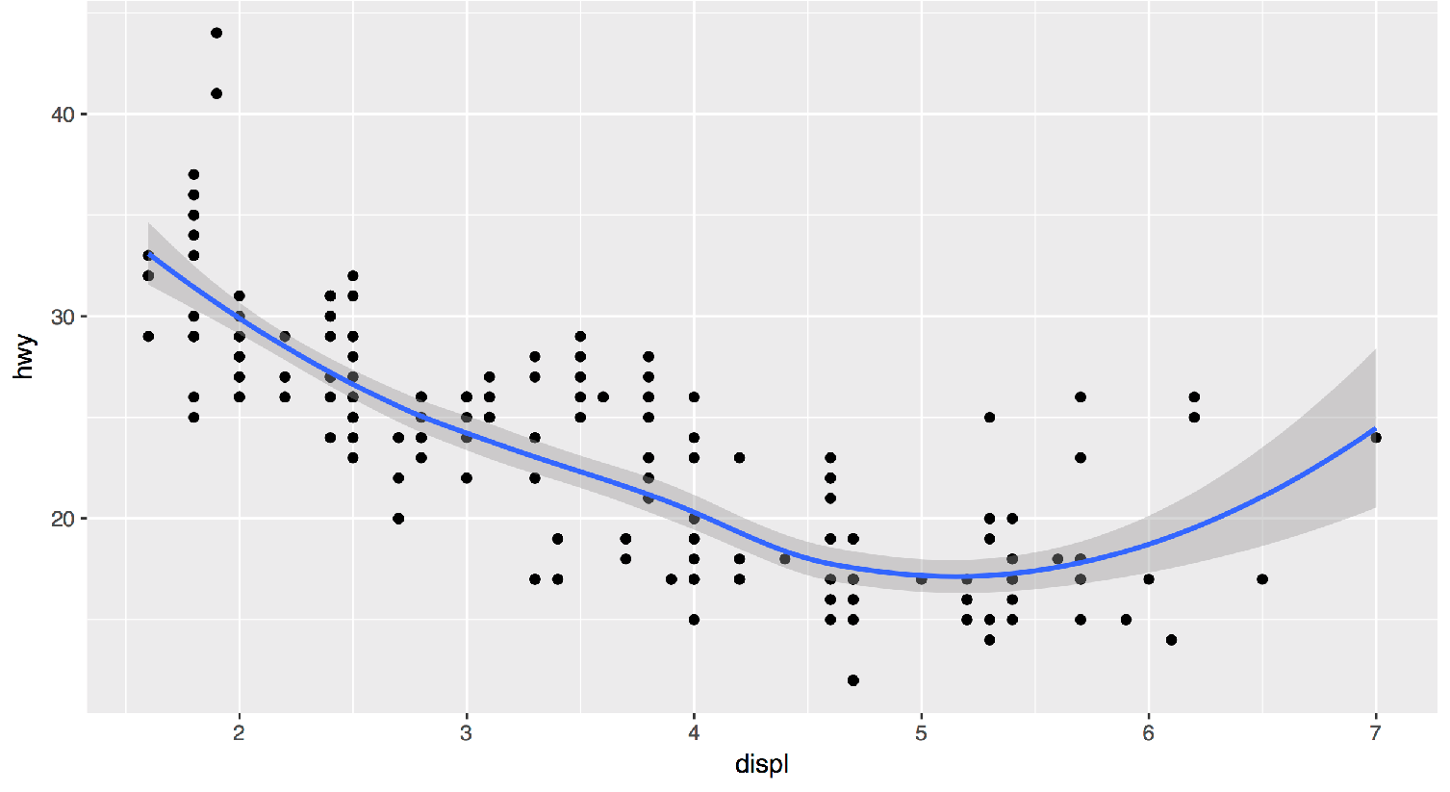
Each new geom adds a new layer
ggplot(data = mpg) +
geom_point(mapping = aes(x = displ, y = hwy)) + geom_smooth(mapping = aes(x = displ, y = hwy))

Slide 54
Each new geom adds a new layer
ggplot(data = mpg) +
geom_point(mapping = aes(x = displ, y = hwy)) + geom_smooth(mapping = aes(x = displ, y = hwy))

Slide 55
global vs. local

Slide 56
Mappings (and data) that appear in ggplot() will apply globally to every layer
ggplot(data = mpg, mapping = aes(x = displ, y = hwy)) + geom_point() +
geom_smooth()

Slide 57
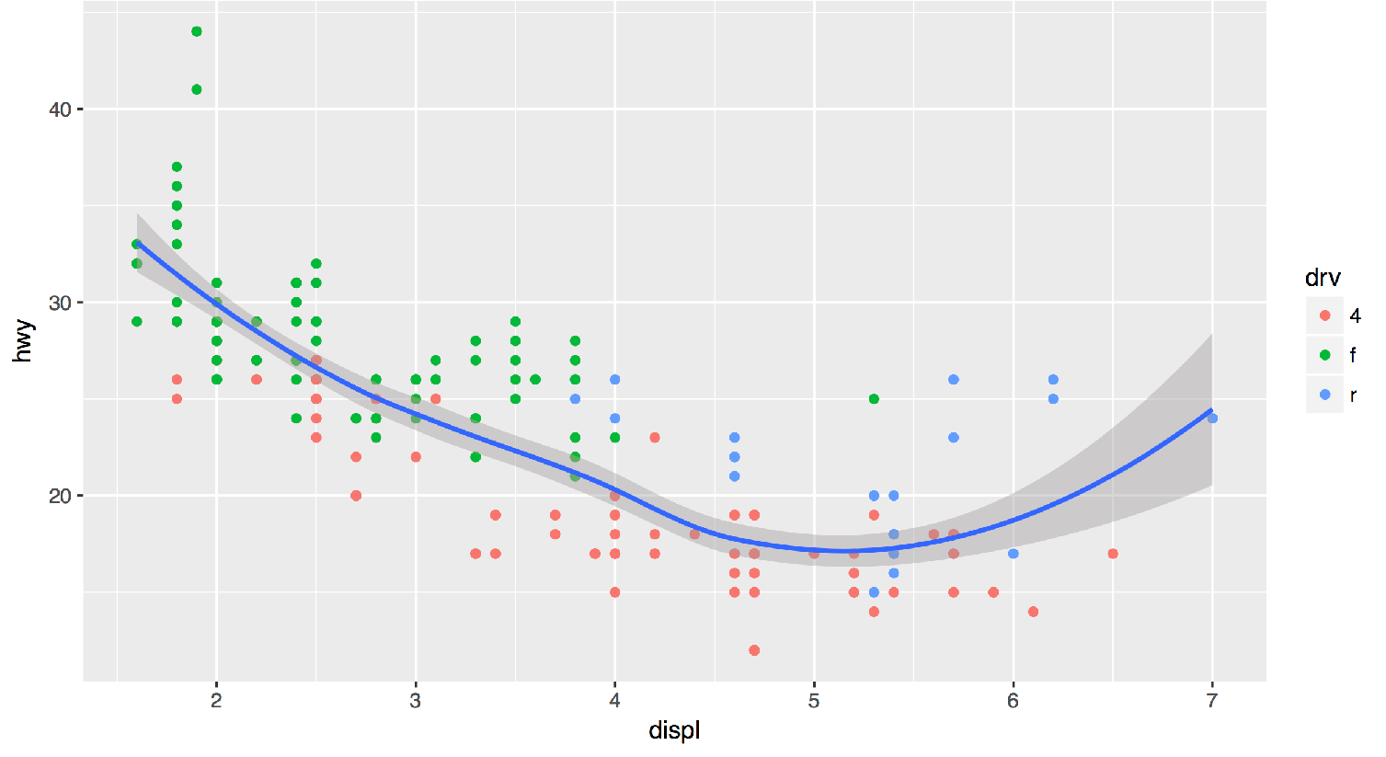
Mappings (and data) that appear in a geom_ function will add to or override the global mappings for that layer only
ggplot(data = mpg, mapping = aes(x = displ, y = hwy)) + geom_point(mapping = aes(color = drv)) + geom_smooth()

Slide 58
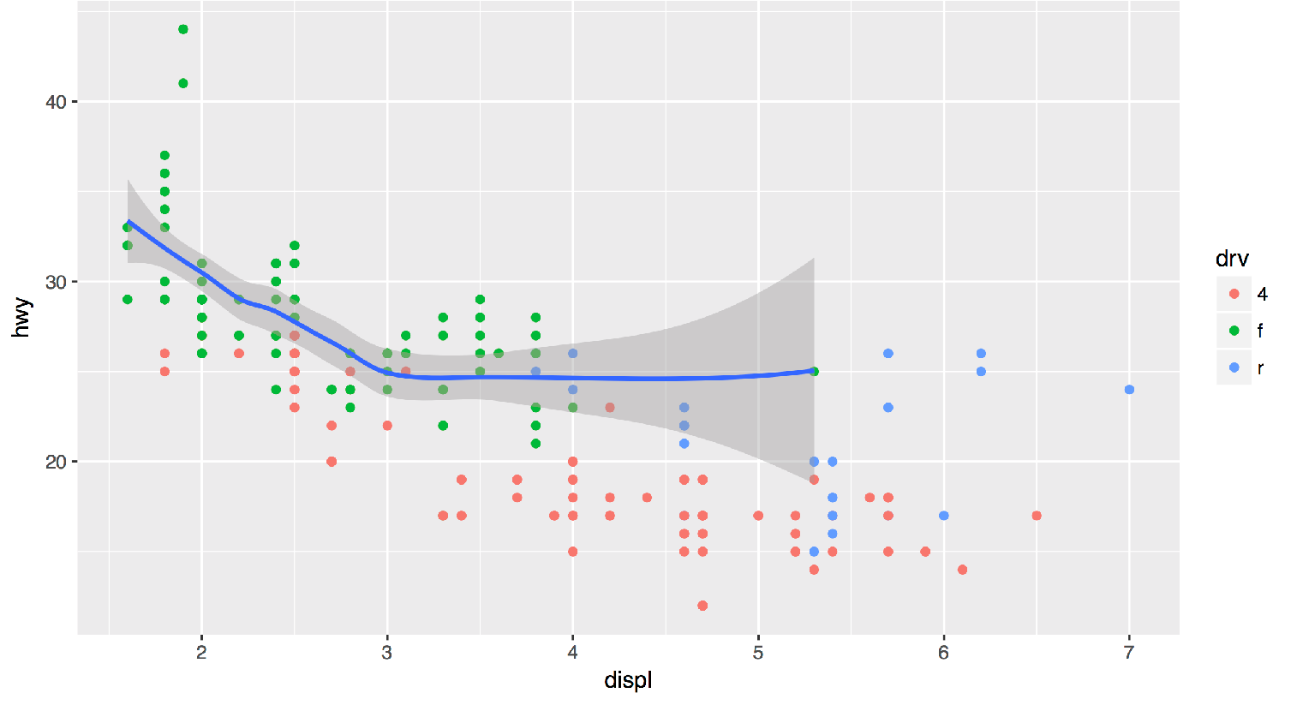
Data can also be set locally or globally
ggplot(data = mpg, mapping = aes(x = displ, y = hwy)) + geom_point(mapping = aes(color = drv)) + geom_smooth(data = filter(mpg, drv == "f"))

Slide 59
Quiz
What is diﬀerent about this plot? Run the code!
p <- ggplot(mpg) + geom_point(aes(displ, hwy)) + geom_smooth(aes(displ, hwy))
library(plotly) ggplotly(p)
58

Slide 60
interactivity

Slide 61

Plotly
Tools for making interactive plots. plot.ly/ggplot2/

Slide 62
Saving graphs
61

Slide 63
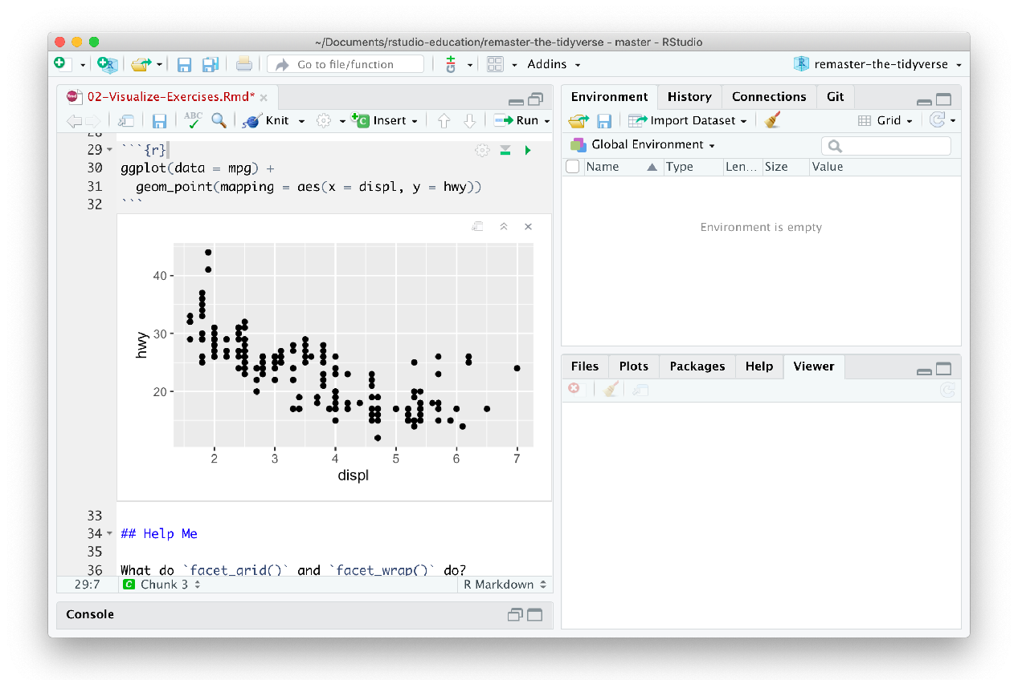
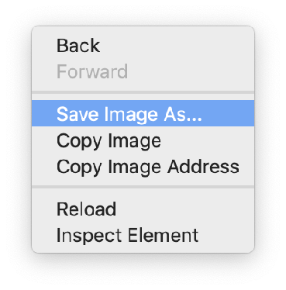
GUI method
Right click on the plot

Slide 64
Code method
ggsave() saves the last plot. Uses size on screen:
ggsave("my-plot.pdf") ggsave("my-plot.png")
Specify size in inches
ggsave("my-plot.pdf", width = 6, height = 6)
Q: But where will
it save it?
A: Alongside
your .Rmd

Slide 65
Plotly
with
Tools for making interactive plots. plot.ly/ggplot2/
htmlwidgets::saveWidget()
Save

Slide 66
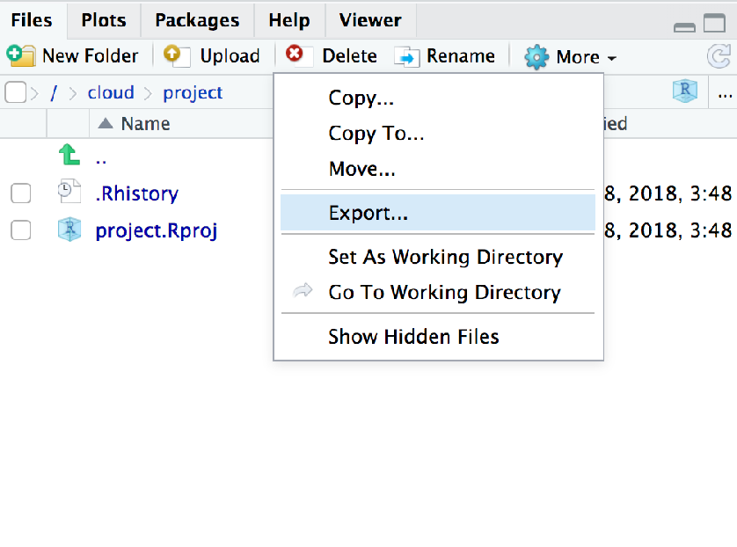
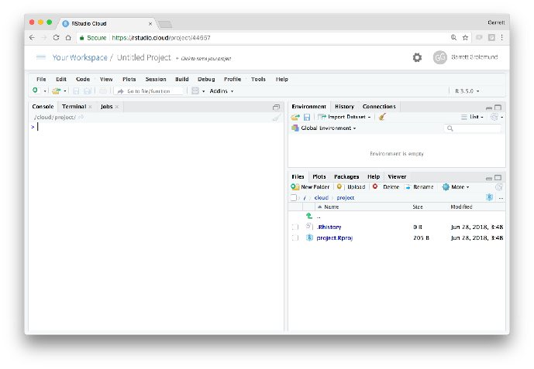
Download files
In the files pane, check next to the file(s) to download More > Export

Slide 67
Grammar of Graphics
66

Slide 68

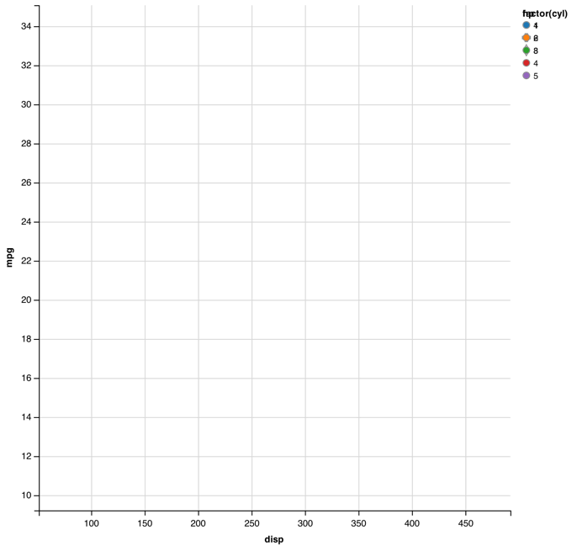

mpg | cyl | disp | hp
21.0 | 6 | 160.0 | 2
21.0 | 6 | 160.0 | 2
22.8 | 4 | 108.0 | 1
21.4 | 6 | 258.0 | 2
18.7 | 8 | 360.0 | 3
18.1 | 6 | 225.0 | 2
14.3 | 8 | 360.0 | 5
24.4 | 4 | 146.7 | 1
22.8 | 4 | 140.8 | 1
19.2 | 6 | 167.6 | 2
17.8 | 6 | 167.6 | 2
16.4 | 8 | 275.8 | 3
17.3 | 8 | 275.8 | 3
15.2 | 8 | 275.8 | 3
10.4 | 8 | 472.0 | 4
10.4 | 8 | 460.0 | 4
14.7 | 8 | 440.0 | 4
32.4 | 4 | 78.7 | 1
30.4 | 4 | 75.7 | 1
33.9 | 4 | 71.1 | 1
data
geom

Slide 69








mappings
fill
mpg | cyl | disp | hp
21.0 | 6 | 160.0 | 2
21.0 | 6 | 160.0 | 2
22.8 | 4 | 108.0 | 1
21.4 | 6 | 258.0 | 2
18.7 | 8 | 360.0 | 3
18.1 | 6 | 225.0 | 2
14.3 | 8 | 360.0 | 5
24.4 | 4 | 146.7 | 1
22.8 | 4 | 140.8 | 1
19.2 | 6 | 167.6 | 2
17.8 | 6 | 167.6 | 2
16.4 | 8 | 275.8 | 3
17.3 | 8 | 275.8 | 3
15.2 | 8 | 275.8 | 3
10.4 | 8 | 472.0 | 4
10.4 | 8 | 460.0 | 4
14.7 | 8 | 440.0 | 4
32.4 | 4 | 78.7 | 1
30.4 | 4 | 75.7 | 1
33.9 | 4 | 71.1 | 1
data
geom

Slide 70
mappings
shape
fill
mpg | cyl | disp | hp
21.0 | 6 | 160.0 | 2
21.0 | 6 | 160.0 | 2
22.8 | 4 | 108.0 | 1
21.4 | 6 | 258.0 | 2
18.7 | 8 | 360.0 | 3
18.1 | 6 | 225.0 | 2
14.3 | 8 | 360.0 | 5
24.4 | 4 | 146.7 | 1
22.8 | 4 | 140.8 | 1
19.2 | 6 | 167.6 | 2
17.8 | 6 | 167.6 | 2
16.4 | 8 | 275.8 | 3
17.3 | 8 | 275.8 | 3
15.2 | 8 | 275.8 | 3
10.4 | 8 | 472.0 | 4
10.4 | 8 | 460.0 | 4
14.7 | 8 | 440.0 | 4
32.4 | 4 | 78.7 | 1
30.4 | 4 | 75.7 | 1
33.9 | 4 | 71.1 | 1
data
geom

Slide 71
mappings
shape x
fill
mpg | cyl | disp | hp
21.0 | 6 | 160.0 | 2
21.0 | 6 | 160.0 | 2
22.8 | 4 | 108.0 | 1
21.4 | 6 | 258.0 | 2
18.7 | 8 | 360.0 | 3
18.1 | 6 | 225.0 | 2
14.3 | 8 | 360.0 | 5
24.4 | 4 | 146.7 | 1
22.8 | 4 | 140.8 | 1
19.2 | 6 | 167.6 | 2
17.8 | 6 | 167.6 | 2
16.4 | 8 | 275.8 | 3
17.3 | 8 | 275.8 | 3
15.2 | 8 | 275.8 | 3
10.4 | 8 | 472.0 | 4
10.4 | 8 | 460.0 | 4
14.7 | 8 | 440.0 | 4
32.4 | 4 | 78.7 | 1
30.4 | 4 | 75.7 | 1
33.9 | 4 | 71.1 | 1
data
geom

Slide 72


mappings
y shape x
fill
mpg | cyl | disp | hp
21.0 | 6 | 160.0 | 2
21.0 | 6 | 160.0 | 2
22.8 | 4 | 108.0 | 1
21.4 | 6 | 258.0 | 2
18.7 | 8 | 360.0 | 3
18.1 | 6 | 225.0 | 2
14.3 | 8 | 360.0 | 5
24.4 | 4 | 146.7 | 1
22.8 | 4 | 140.8 | 1
19.2 | 6 | 167.6 | 2
17.8 | 6 | 167.6 | 2
16.4 | 8 | 275.8 | 3
17.3 | 8 | 275.8 | 3
15.2 | 8 | 275.8 | 3
10.4 | 8 | 472.0 | 4
10.4 | 8 | 460.0 | 4
14.7 | 8 | 440.0 | 4
32.4 | 4 | 78.7 | 1
30.4 | 4 | 75.7 | 1
33.9 | 4 | 71.1 | 1
data
geom

Slide 73
mappings
y shape x
fill
mpg | cyl | disp | hp
21.0 | 6 | 160.0 | 2
21.0 | 6 | 160.0 | 2
22.8 | 4 | 108.0 | 1
21.4 | 6 | 258.0 | 2
18.7 | 8 | 360.0 | 3
18.1 | 6 | 225.0 | 2
14.3 | 8 | 360.0 | 5
24.4 | 4 | 146.7 | 1
22.8 | 4 | 140.8 | 1
19.2 | 6 | 167.6 | 2
17.8 | 6 | 167.6 | 2
16.4 | 8 | 275.8 | 3
17.3 | 8 | 275.8 | 3
15.2 | 8 | 275.8 | 3
10.4 | 8 | 472.0 | 4
10.4 | 8 | 460.0 | 4
14.7 | 8 | 440.0 | 4
32.4 | 4 | 78.7 | 1
30.4 | 4 | 75.7 | 1
33.9 | 4 | 71.1 | 1
data
geom
points
lines

Slide 74
mappings
y
x
mpg | cyl | disp | hp
21.0 | 6 | 160.0 | 2
21.0 | 6 | 160.0 | 2
22.8 | 4 | 108.0 | 1
21.4 | 6 | 258.0 | 2
18.7 | 8 | 360.0 | 3
18.1 | 6 | 225.0 | 2
14.3 | 8 | 360.0 | 5
24.4 | 4 | 146.7 | 1
22.8 | 4 | 140.8 | 1
19.2 | 6 | 167.6 | 2
17.8 | 6 | 167.6 | 2
16.4 | 8 | 275.8 | 3
17.3 | 8 | 275.8 | 3
15.2 | 8 | 275.8 | 3
10.4 | 8 | 472.0 | 4
10.4 | 8 | 460.0 | 4
14.7 | 8 | 440.0 | 4
32.4 | 4 | 78.7 | 1
30.4 | 4 | 75.7 | 1
33.9 | 4 | 71.1 | 1
data
geom
points
lines
bars

Slide 75
mappings
y
xfill
mpg | cyl | disp | hp
21.0 | 6 | 160.0 | 2
21.0 | 6 | 160.0 | 2
22.8 | 4 | 108.0 | 1
21.4 | 6 | 258.0 | 2
18.7 | 8 | 360.0 | 3
18.1 | 6 | 225.0 | 2
14.3 | 8 | 360.0 | 5
24.4 | 4 | 146.7 | 1
22.8 | 4 | 140.8 | 1
19.2 | 6 | 167.6 | 2
17.8 | 6 | 167.6 | 2
16.4 | 8 | 275.8 | 3
17.3 | 8 | 275.8 | 3
15.2 | 8 | 275.8 | 3
10.4 | 8 | 472.0 | 4
10.4 | 8 | 460.0 | 4
14.7 | 8 | 440.0 | 4
32.4 | 4 | 78.7 | 1
30.4 | 4 | 75.7 | 1
33.9 | 4 | 71.1 | 1
data
geom
points
lines bars

Slide 76
To make a graph
ggplot(data = <DATA>) +
<GEOM_FUNCTION>(mapping = aes(<MAPPINGS>))
[template]

Slide 77
To make a graph
1. Pick a data set
ggplot(data = <DATA>) +
<GEOM_FUNCTION>(mapping = aes(<MAPPINGS>))
mpg | cyl | disp | hp
21.0 | 6 | 160.0 | 2
21.0 | 6 | 160.0 | 2
22.8 | 4 | 108.0 | 1
21.4 | 6 | 258.0 | 2
18.7 | 8 | 360.0 | 3
18.1 | 6 | 225.0 | 2
14.3 | 8 | 360.0 | 5
24.4 | 4 | 146.7 | 1
22.8 | 4 | 140.8 | 1
19.2 | 6 | 167.6 | 2
17.8 | 6 | 167.6 | 2
16.4 | 8 | 275.8 | 3
17.3 | 8 | 275.8 | 3
15.2 | 8 | 275.8 | 3
10.4 | 8 | 472.0 | 4
10.4 | 8 | 460.0 | 4
14.7 | 8 | 440.0 | 4
32.4 | 4 | 78.7 | 1
30.4 | 4 | 75.7 | 1
33.9 | 4 | 71.1 | 1
data

Slide 78
To make a graph
Pick a data set
ggplot(data = <DATA>) +
<GEOM_FUNCTION>(mapping = aes(<MAPPINGS>))
Choose a geom
to display cases
mpg | cyl | disp | hp
21.0 | 6 | 160.0 | 2
21.0 | 6 | 160.0 | 2
22.8 | 4 | 108.0 | 1
21.4 | 6 | 258.0 | 2
18.7 | 8 | 360.0 | 3
18.1 | 6 | 225.0 | 2
14.3 | 8 | 360.0 | 5
24.4 | 4 | 146.7 | 1
22.8 | 4 | 140.8 | 1
19.2 | 6 | 167.6 | 2
17.8 | 6 | 167.6 | 2
16.4 | 8 | 275.8 | 3
17.3 | 8 | 275.8 | 3
15.2 | 8 | 275.8 | 3
10.4 | 8 | 472.0 | 4
10.4 | 8 | 460.0 | 4
14.7 | 8 | 440.0 | 4
32.4 | 4 | 78.7 | 1
30.4 | 4 | 75.7 | 1
33.9 | 4 | 71.1 | 1
data
geom

Slide 79

To make a graph
mappings
fill
1. Pick a data set
ggplot(data = <DATA>) +
<GEOM_FUNCTION>(mapping = aes(<MAPPINGS>))
mpg | cyl | disp | hp
21.0 | 6 | 160.0 | 2
21.0 | 6 | 160.0 | 2
22.8 | 4 | 108.0 | 1
21.4 | 6 | 258.0 | 2
18.7 | 8 | 360.0 | 3
18.1 | 6 | 225.0 | 2
14.3 | 8 | 360.0 | 5
24.4 | 4 | 146.7 | 1
22.8 | 4 | 140.8 | 1
19.2 | 6 | 167.6 | 2
17.8 | 6 | 167.6 | 2
16.4 | 8 | 275.8 | 3
17.3 | 8 | 275.8 | 3
15.2 | 8 | 275.8 | 3
10.4 | 8 | 472.0 | 4
10.4 | 8 | 460.0 | 4
14.7 | 8 | 440.0 | 4
32.4 | 4 | 78.7 | 1
30.4 | 4 | 75.7 | 1
33.9 | 4 | 71.1 | 1
3. Map aesthetic properties to variables
2. Choose a geom
to display cases
data
geom

Slide 80
What else?
79

Slide 81
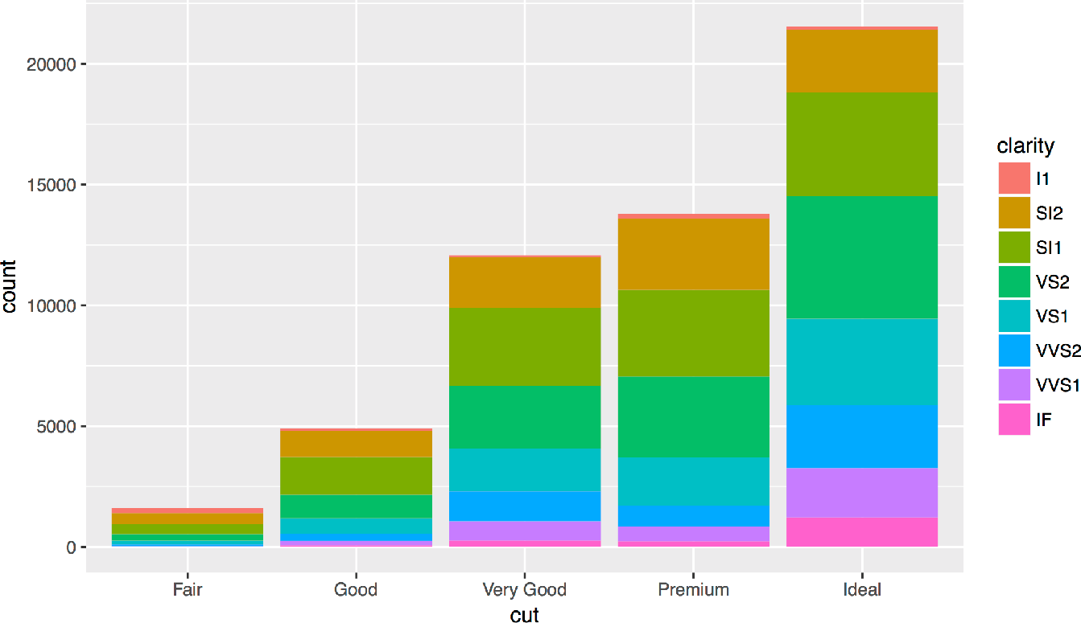

Slide 82
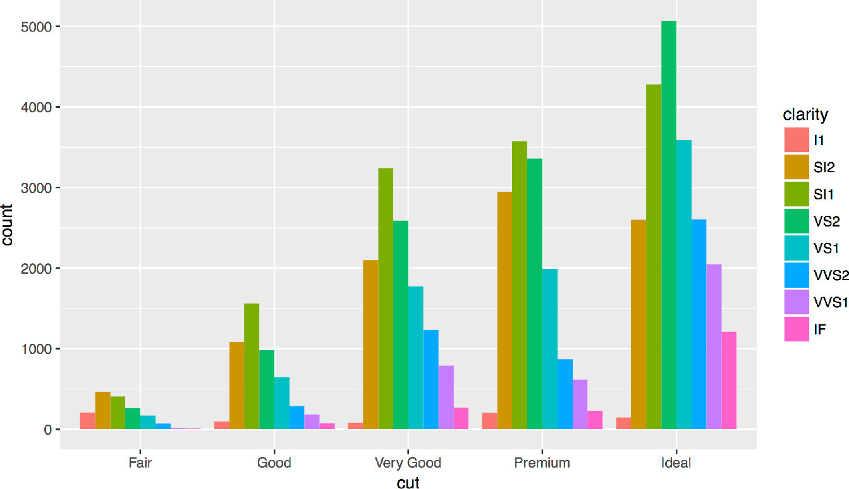
Position Adjustments
How overlapping objects are arranged

Slide 83
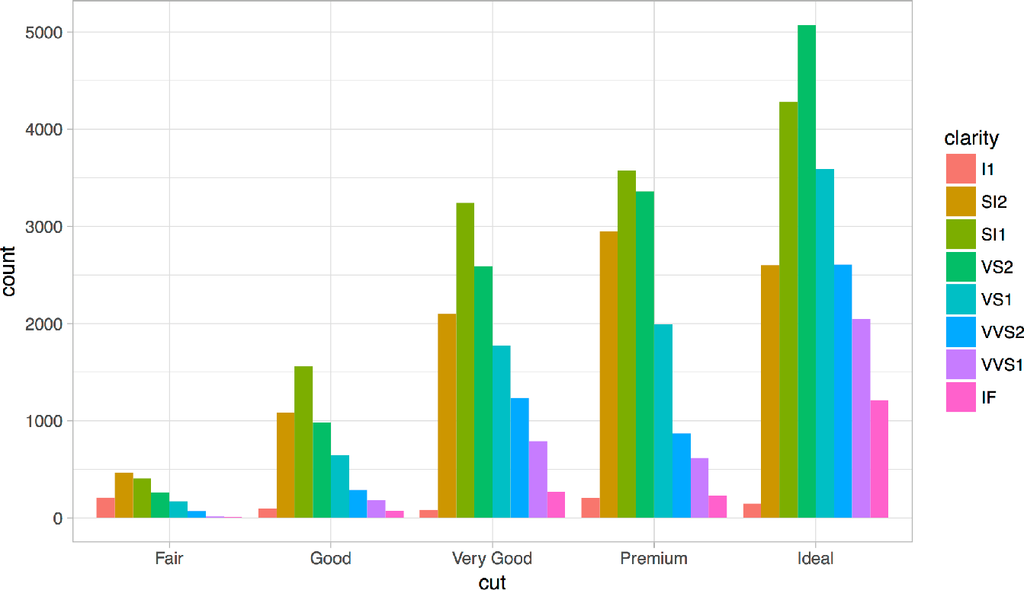
Themes
Visual appearance of non-data elements
+ theme_bw()

Slide 84
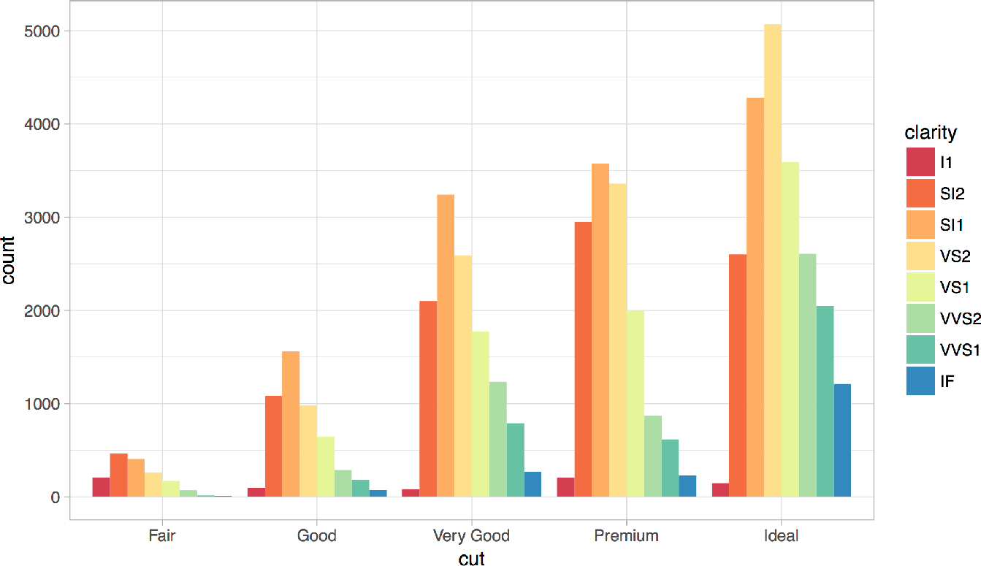
Scales
Customize color scales, other mappings

Slide 85
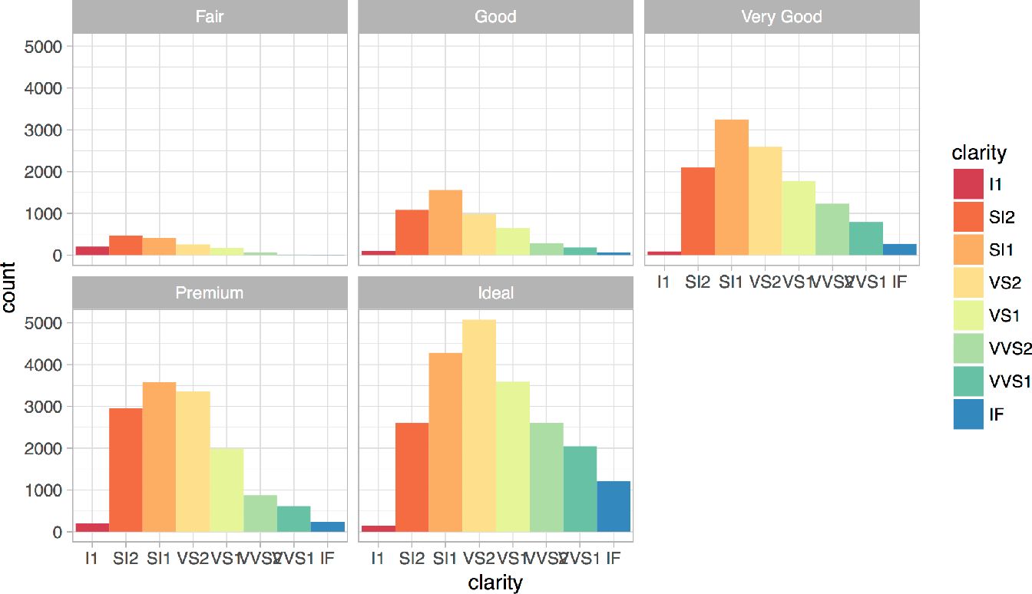
Facets
Subplots that display subsets of the data.

Slide 86
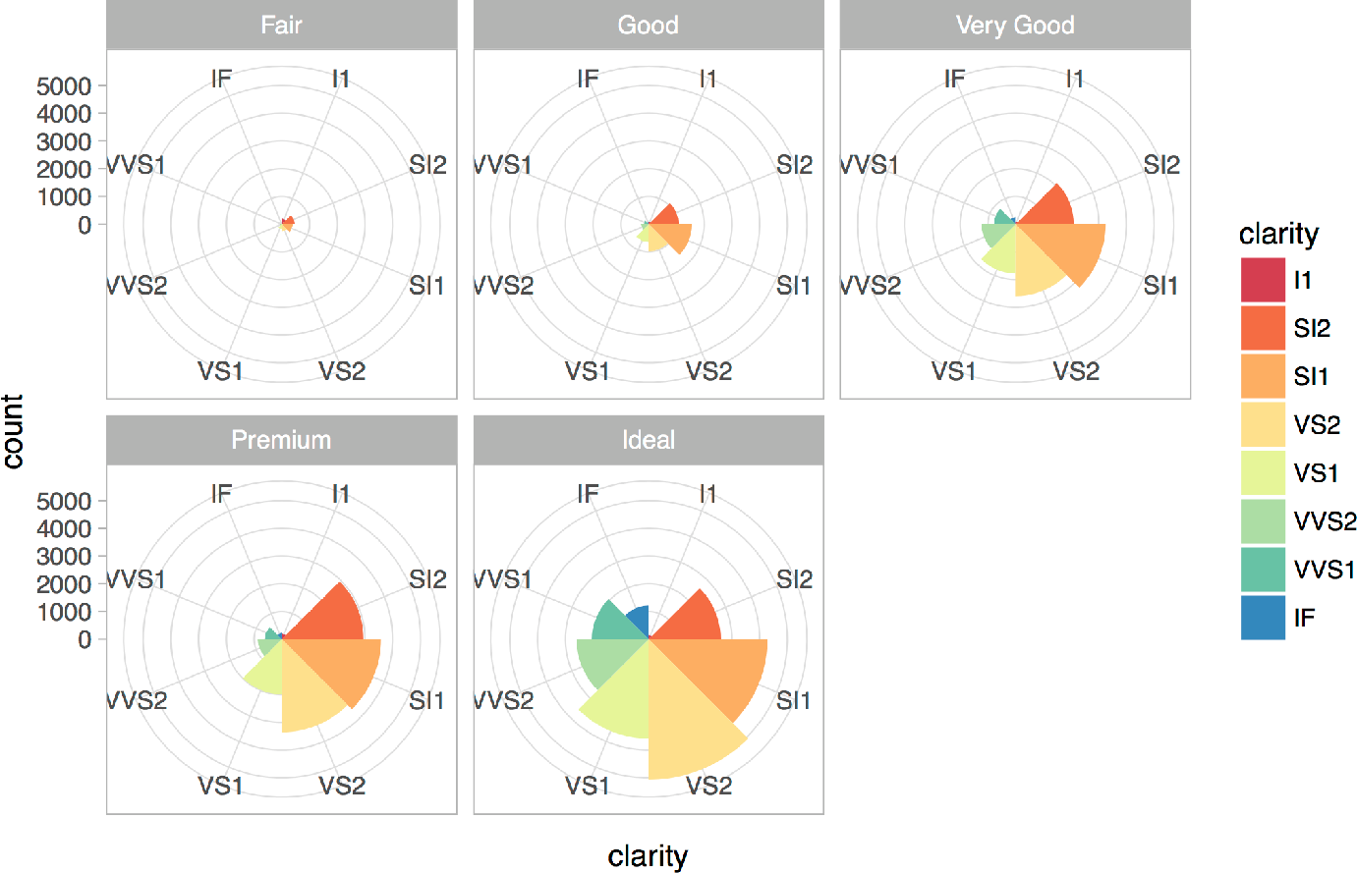
Coordinate systems

Slide 87
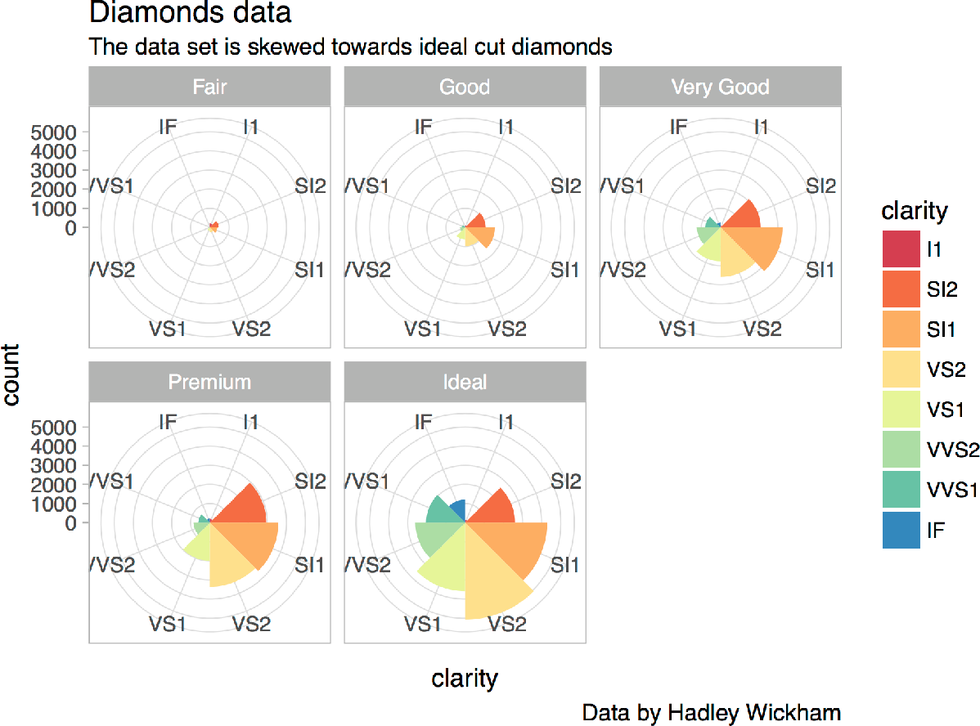
Titles and captions

Slide 88
A ggplot2 template
Make any plot by filling in the parameters of this template
Complete the template below to build a graph.
ggplot (data = <DATA> ) +
required
<GEOM_FUNCTION> (mapping = aes( <MAPPINGS> ),
stat = <STAT> , position = <POSITION> ) +
<COORDINATE_FUNCTION> +
<FACET_FUNCTION> +
<SCALE_FUNCTION> +
<THEME_FUNCTION>
Not
required,
sensible defaults supplied
87

Slide 89
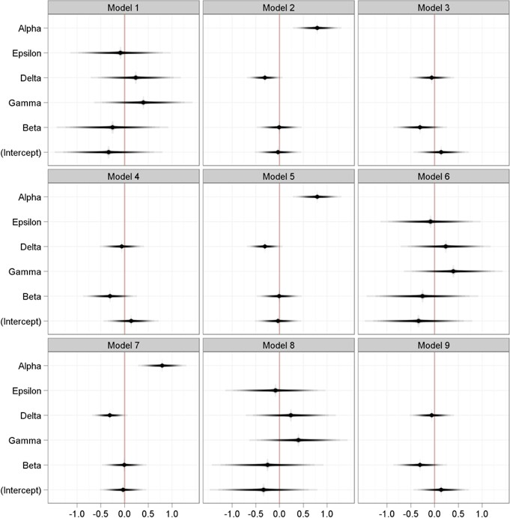
David B Sparks, http://bit.ly/hn54NW

Slide 90
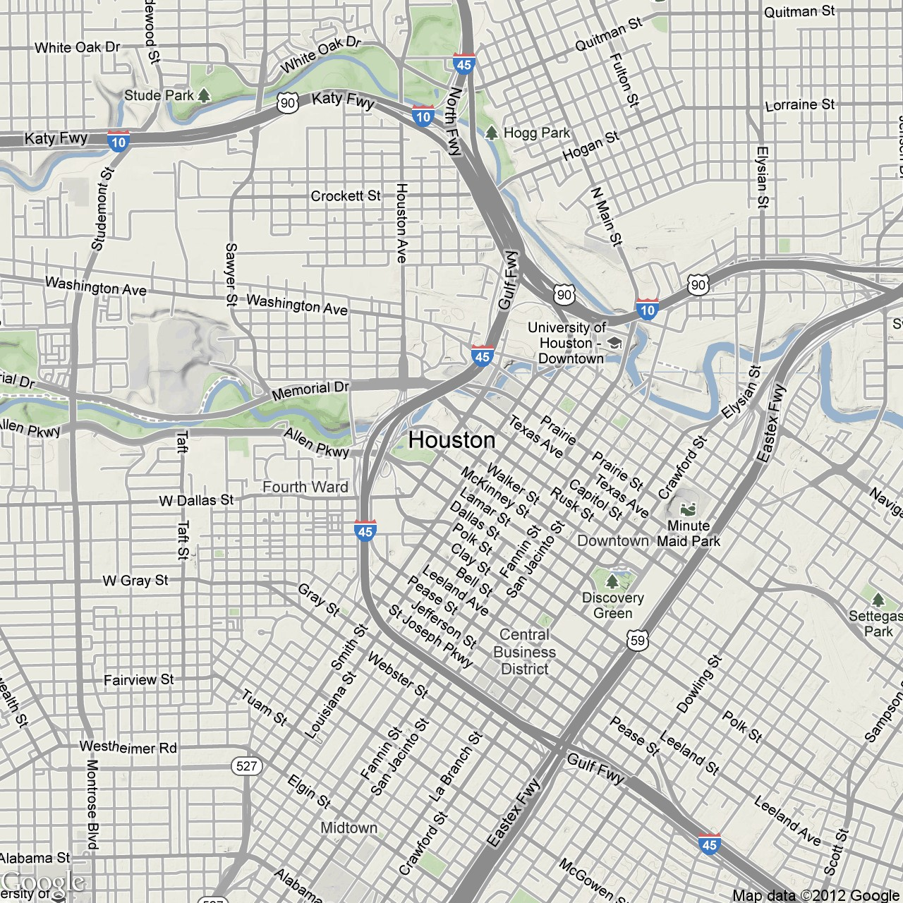
Violent Crime Density
1400
1200
1000
800
600
400
David Kahle, https://dl.dropbox.com/u/24648660/ggmap%20useR%202012.pdf

Slide 91
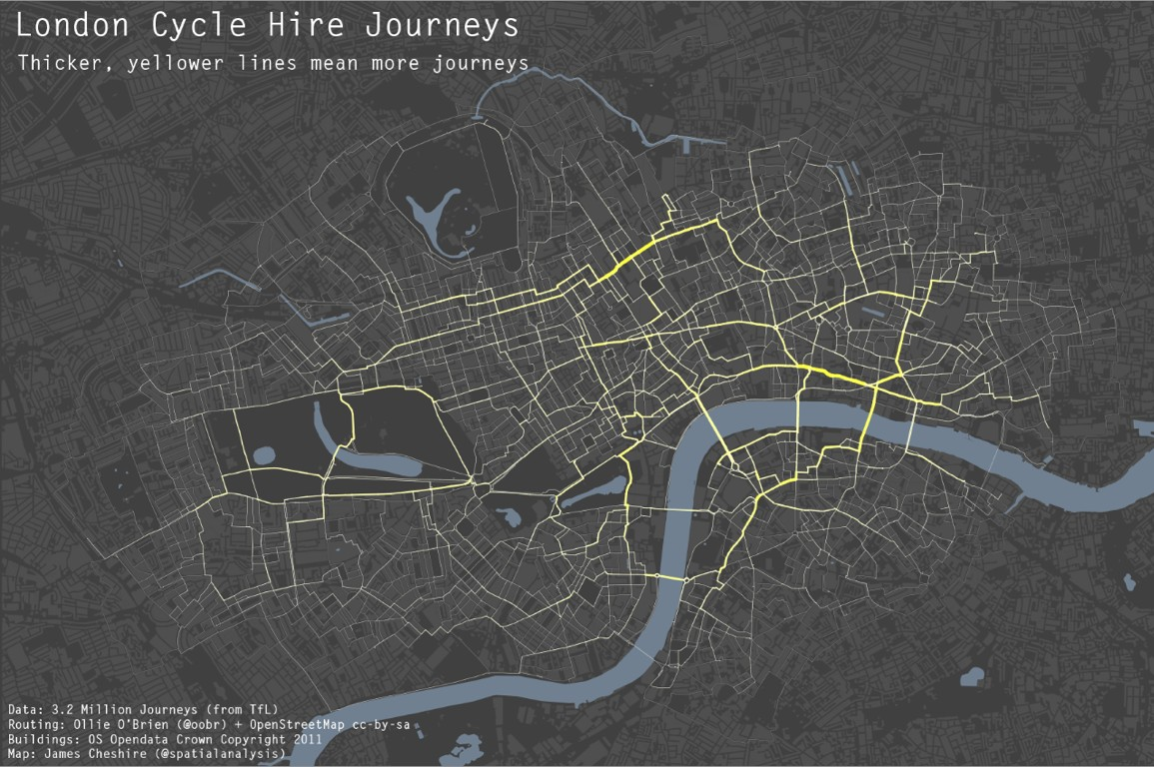
James Cheshire, http://bit.ly/xqHhAs

Slide 92
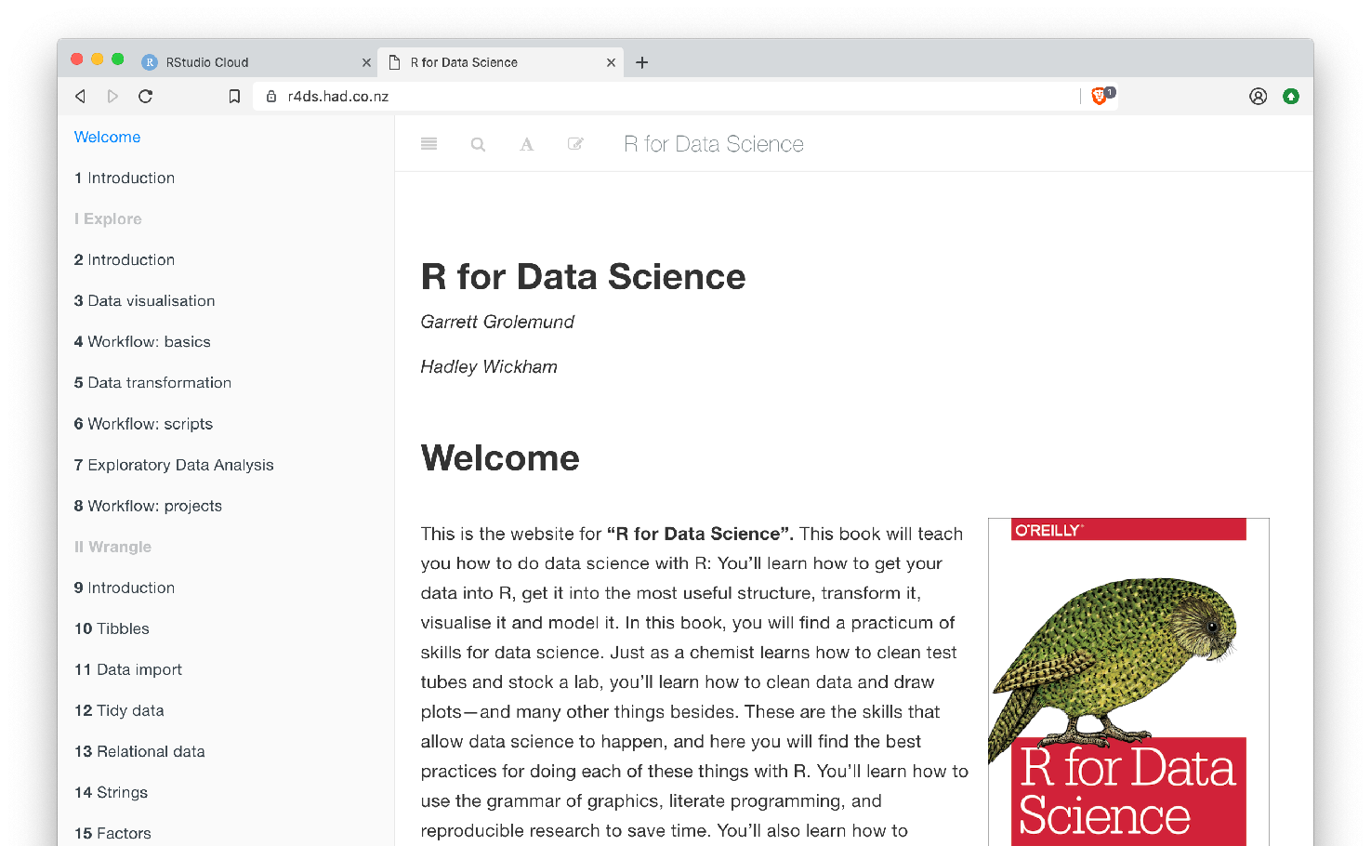
r4ds.had.co.nz
The ultimate
Complete
resource for
and free
online
the training

Slide 93
Your Turn
Navigate up to the 03-Transform folder. Open 03-Transform-Exercises.Rmd
92

Slide 94
Visualize Data with
Slides CC BY-SA RStudio

